Slide 1
Final Project – NLP for Healthcare CSE 6250 – Big Data for health informatics MS in Computer Science Georgia Institute of Technology Date: May 2nd, 2021 By: Sang Yoon Hwang, Prateek Gupta, Venkata Shyam K Tumuluri

Slide 2



Introduction
Clinical notes - annotated by medical codes which uniquely identify each patient’s diagnosis, health condition and treatment type
ICD-9 code – classification of patient’s disease
Need automation tool to predict ICD-9 codes from clinical notes
Machine learning techniques such as convolutional neural network (CNN), Gated Recurrent Unit Network (GRU) and long short-term memory networks (LSTM) that predict medical codes from clinical text documents are implemented
The purpose of our paper is to reproduce the result from the paper "Explainable Prediction of Medical Codes from Clinical Text" by James Mullenbach, Sarah Wiegreffe, Jon Duke, Jimeng Sun and Jacob Eisenstein (and 1 additional tweak - LSTM)

Slide 3
Methodologies
Data Processing and Cleaning
Loaded MIMIC III datasets into HDFS (Hadoop 3.2) and processed the datasets using Spark 3.1
Data sources
Discharge summaries corresponding to patient summaries are provided in NOTEEVENTS.csv
All diagnostic ICD9 codes and procedural ICD9 codes are provided in DIAGNOSES_ICD.csv and PROEDURES_ICD.csv files
Feature Extraction
Word2Vec embedding are created using Spark API for every tokenized word from a document
For all 3 models, the embedding size is set to 100
Dictionary maps an integer value to the word embedding
The number of words in each document is limited to 500
The shape of the labels is a 1D tensor consisting of One hot encoding of each ICD9 code tagged to corresponding summary

Slide 4

Model approach
Our approach is mostly consistent with the paper, “Explainable prediction of medical codes from clinical text” - CAML (Convolution Attention For Multi-Label Classification
Additional model added: LSTM model which was not included in above paper
We implemented 3 different models
Binary Cross Entropy with logistic loss as the loss function
sigmoid function, providing the probabilities for each ICD9 code
LSTM – Long Short Term Memory
Parameter grid we used for LSTM is following:
(embeddings): Embedding(57205, 100)
(LSTMCell): LSTM(100, 32, batch_first=True)
(FullyConnectedOutput): Linear(in_features=32, out_features=8929, bias=True)
GRU – Gated Recurrent Unit
Parameter grid we used for GRU is following:
(embeddings): Embedding(57205, 100)
(GRUCell): GRU(100, 16, batch_first=True, bidirectional=True)
(FullyConnectedOutput): Linear(in_features=32, out_features=8929, bias=True)

Slide 5
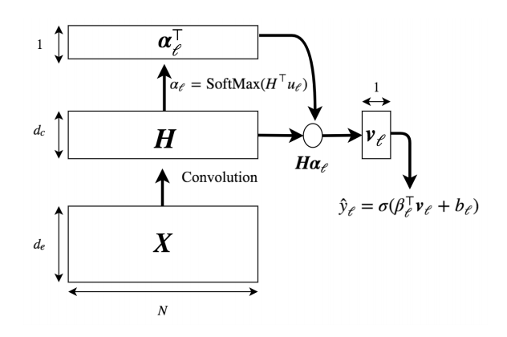
Model approach – cont’d
CAML
Batch size of 32
Maximum number of words allowed in the text is 500
The embedding size is 100 - used 50 as output filter size
The size of the labels recorded for training is 8929
Input Size: torch.Size([32, 500, 1])
Conversion of the tensor into embedding layer: torch.Size([32, 500, 100])
Application of convolution and tanh activation functon: torch.Size([32, 500, 50])
Attention vectors for each label collected into a matrix: torch.Size([8929, 50])
Alpha, which is the attention layer used instead of maxpooling: torch.Size([32, 8929, 500])
Vector matrix when alpha multiplies with convolution output: torch.Size([32, 8929, 50])
Output shape which is a list vectors for producing a binary classification for each label: torch.Size([32, 8929])

Slide 6
Experimental Results
** bracket = average value
Micro AUC | Macro AUC | Micro F1 | Macro F1 | Value Type | Model Type
0.973 (0.974) | 0.965 (0.973) | 0.428 (0.422) | 0.761 (0.744) | Train | CAML
0.967 (0.973) | 0.974 (0.971) | 0.387 (0.430) | 0.834 (0.750) | Test | CAML
0.951 (0.957) | 0.942 (0.955) | 0.190 (0.226) | 0.481 (0.547) | Train | GRU
0.958 (0.957) | 0.958 (0.954) | 0.200 (0.238) | 0.589 (0.551) | Test | GRU
0.963 (0.960) | 0.955 (0.956) | 0.260 (0.235) | 0.571 (0.548) | Train | LSTM
0.954 (0.960) | 0.871 (0.956) | 0.278 (0.248) | 0.631 (0.546) | Test | LSTM

Slide 7
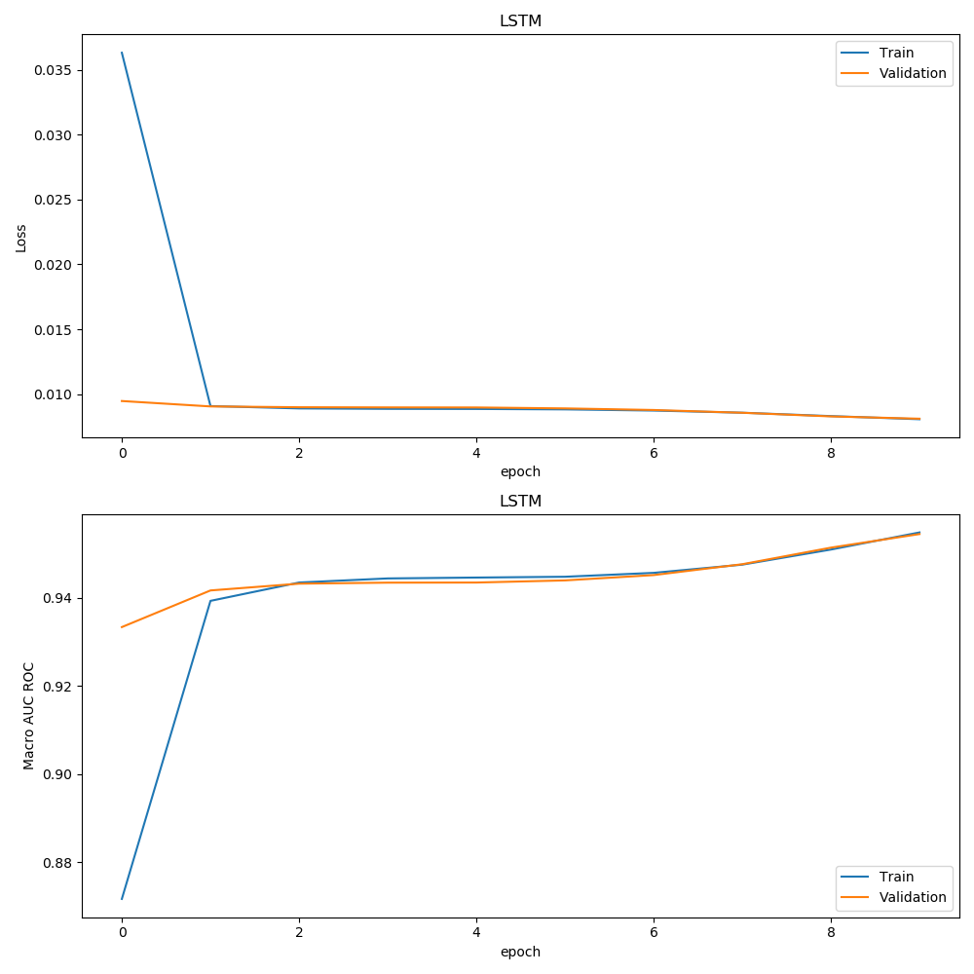
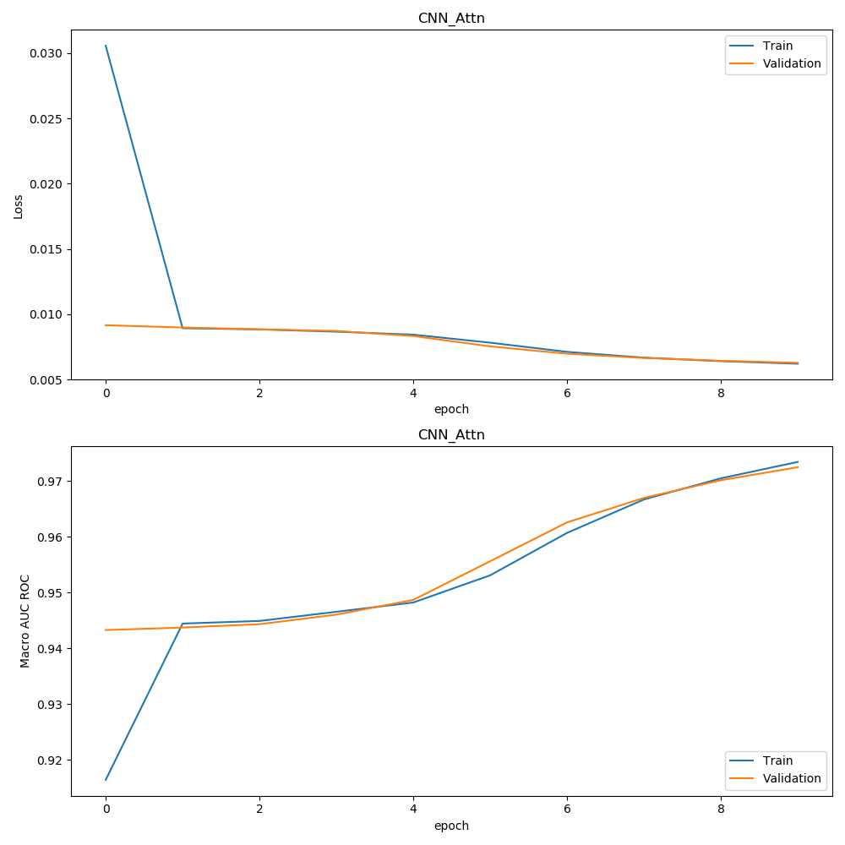
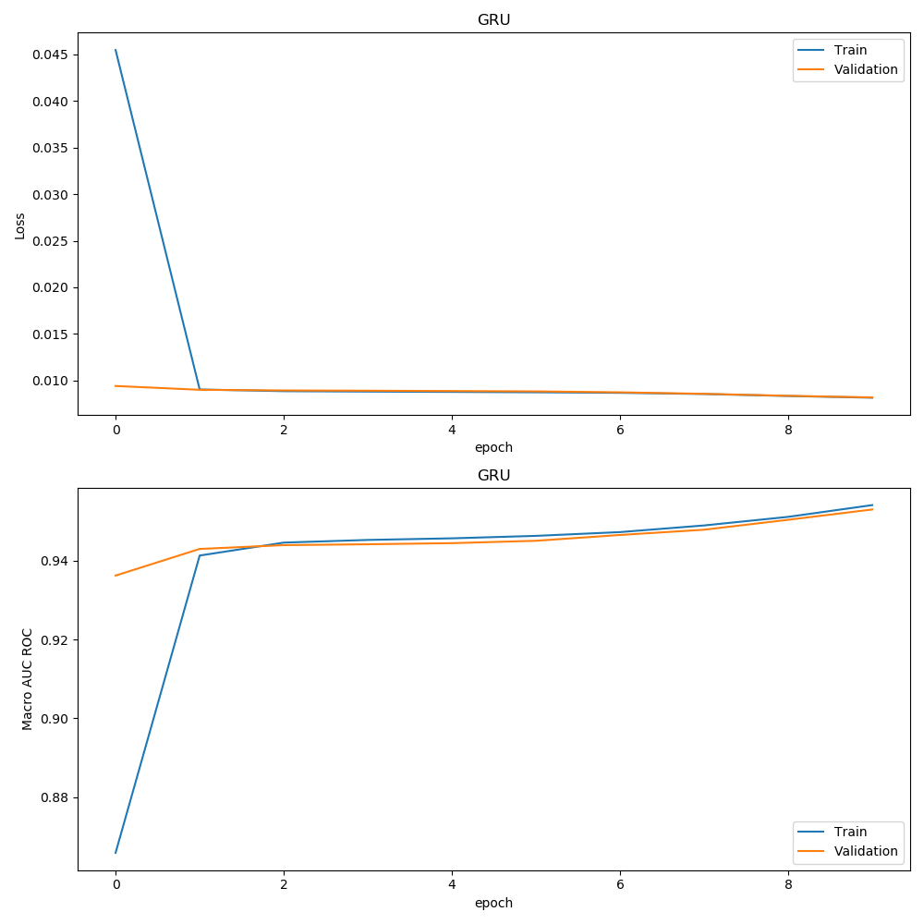
Discussion
CAML was the best performer in terms of both AUC and F1
Notably with macro-AUC with 0.971 for average value on test set
Loss for each model is becoming smaller as epoch increases
To counter overfitting issue, implemented Xavier initialisation
Top 5 ICD-9 code predictions in terms of probability score ranking for each model on test set are:
CAML (401.9,427.31,414.01,428.0,38.93)
GRU (401.9,38.93,427.31,428.0,414.01)
LSTM (401.9,38.93,427.31,96.04,428.0)

Slide 8
Summary
Used multi-label classification methods, CAML, GRU and LSTM, with trained word vectors from the clinical notes to predict ICD-9 codes
Configured layers and corresponding parameters for each model to understand where models produce the highest F1 and AUC
Big data pre-processing tools such as Hadoop and PySpark were used
Xavier initialisation used to counter overfitting on training data because of improper initialization
The best performed model was CAML – notably, with macro-AUC for average value of 0.971 on test set
Embedding size maxed out to 1000 and batch size to 32 to fit in GPU memory
Performance metrics calculated as tensors on GPU to avoid data migration overhead

Slide 9
Improvement Scope
Richer dataset with demographics information of the patients
Increasing size of embedding matrix to allow more model capacity, balanced with introduction of dropouts
Pareto selection to use the model for highly frequent ICD-9 codes
Train model for more epochs
ICD-9 codes grouping as a pre-processing step to predict the group and then individual models for added granularity
Change model architecture to current state of the art

